Slide 1
MT6293 MP1 SQC Workshop 93 Call Domain Selection
15 May 2017

Slide 2
Outline
Introduction
Architecture
ADS Overview
Log Analysis & Case Study Example

Slide 3
Introduction
90/91/92
MD1 and MD3 are separated, VDM only decides call domain selection for IMS and CS call of MD1.
C2K domain selection is handled by AP. AP will send AT cmd request directly to MD3 (CVAL) for C2K call.
93
MD1 and MD3 are merge into a single MD.
VDM decides call domain for IMS and CS and C2K call.
Call related AT cmd/URC
For AP: AT cmd/URC merged as used in MD1
For example: ATD, +ECPI…
Below ATCI/L4C、CVAL: remain the same
For example: for GSM still ATD; for C2K still AT+CDV
Translated in VDM and L4BCC

Slide 4
Architecture
ILM
AT in ILM
SIP
IMS server
90/91/92
IMS server
93
AP
Dialer
AP
Dialer
VoLTE UA
IMSA
(IMS
Adaptor)
Android
Mobile Data Service
Android
Telephony Framework
VoLTE UA
IMSA
(IMS
Adaptor)
Android
Mobile Data Service
Android
Telephony Framework
IMCB
(IMS Core Bearer)
RIL
IMCB
(IMS Core Bearer)
RIL
IMC
(IMS Core)
IMSP
IMC
(IMS Core)
ATP
MD3
VDM
(Voice Domain Manager)
VDM
(Voice Domain Manager)
L4BCC / L4B Group
ATCI / L4C Group
CVAL
ATCI / L4C Group
CVAL
2/3G NAS
LTE NAS
CSS
2/3G NAS
LTE NAS
CSS
MD1
2G AS
3G AS
LTE AS
C2K AS
MD
2G AS
3G AS
LTE AS
C2K AS

Slide 5
Architecture
Interface changes
New module: L4BCC, adaption module between VDM and ATCI/CVAL
After Gen93, VDM will use ILM to request CS/C2K call by sending different ILM groups to L4BCC.
ILM naming can distinguish the request is for CS or C2K call, for example:
CS: MSG_ID_VDM_L4B_CS_CC_MO_CALL_REQ
C2K: MSG_ID_VDM_L4B_C2K_CC_MO_CALL_REQ
L4BCC will interpret ILM as AT command and forward it to corresponding ATCI or CVAL, for example
CS: ATDXXXXX; to ATCI
C2K: AT+CDV=XXXXX to CVAL

Slide 6
ADS Overview – normal call
WIFI IMS
Cellular IMS
hVoLTE Selection Algoritm
C2K
Yes
Reject
User Dial Call
apply hVoLTE?
No
WIFI IMS
Cellular IMS
Normal Selection Algorithm
CS
Reject
Check C2K if rat_mode has C2K

Slide 7
ADS Overview – normal call
apply hVoLTE?
C2K CS is registered => regardless following condition
If one the following condition is true => no; otherwise, yes
l4c_query_hvolte_enable_status() == HVOLTE_DISABLE
Depends on nvram_ef_hvolte_e911_struct->hvolte_enable
CT: HVoLTE_MANUAL_MODE
VzW: HVoLTE_AUTO_MODE
Others: HVoLTE_DISABLE
rat_mode not contain RAT_C2K
is not in home country
from GMSS reported RAT change indication +ERPRAT
CS registration status is roaming

Slide 8
ADS Overview – emergency call
WIFI IMS
Send EMC_SERVICE_SCAN_REQ (AT+EMCSS) to request L4C/GMSS for available ECC rat
Cellular IMS
E911 Selection Procedure
C2K
CS
Yes
emc scan enable?
Reject
Need AP change to
global rat, and redial
User Dial ECC Call
No
WIFI IMS
Cellular IMS
Emergency Selection Algorithm
CS
Reject
Check C2K if rat_mode has C2K

Slide 9
ADS Overview – emergency call
emc scan enable?
nvram_ef_vdm_ads_profile_struct-> nvram_vdm_common_profile_struct-> allow_global_emc_scan
CT, VzW, Sprint: 1
Others: 0

Slide 10
Log Analysis
Keyword (MD log, PS)
primitives
MSG_ID_VDM_IMC_IMS_CC_MO_CALL_REQ
MSG_ID_VDM_L4B_CS_CC_MO_CALL_REQ
MSG_ID_VDM_L4B_C2K_CC_MO_CALL_REQ
MSG_ID_VDM_ATP_EMC_SERVICE_SCAN_REQ
MSG_ID_VDM_ATP_EMC_SERVICE_IND
MSG_ID_VDM_ATP_SND_ECPI_CALL_RELEASE_REQ
trace prefix
[VDM] hVoLTE
vdm_ads_select_domain
ADS algo
SSAC ctrl
Timer:
Regular exp (MD log, PS)
^MSG_ID_VDM_ATP_EMC|MSG_ID_VDM_.*(IMC|L4B).*CALL_REQ|ATP_SND_ECPI_CALL|\[VDM\] hVoLTE|\[VDM ADS\].*(vdm_ads_select_domain|ADS algo|SSAC ctrl|timer:)

Slide 11
Log Analysis – normal call
apply hVoLTE for normal call
C2K CS is registered
C2K CS is not registered, but all condition check ok
not apply hVoLTE for normal call
one of the following reason
followed by
[VDM] hVoLTE_enable : C2K CS reigstered [VDM ADS] vdm_ads_select_domain_for_normal_for_hvolte()
[VDM ADS] vdm_ads_select_domain_for_normal_for_hvolte()
[VDM] hVoLTE_disable : l4c_query_hvolte_enable_status = HVOLTE_DISABLE [VDM] hVoLTE_disable : rat_mode not contain C2K [VDM] hVoLTE_disable : is not home by +EPRAT [VDM] hVoLTE_disable : roaming
[VDM ADS] vdm_ads_select_domain_for_normal()

Slide 12
Log Analysis – normal call
ADS algo: C2K CS domain is allowed to use (a candidate for ADS)
Call is allowed to make in C2K CS domain
ADS algo: C2K CS domain not allowed (reason)
reason
hVoLTE manual mode with hvolte_mode=LTE only
C2K RAT disable
ADS mode = xxxx
There is at least an ongoing IMS call
Debug:
OP load: check VoLTE icon should off
OM load: if CT sim, check with L4 owner Kuan-wei Chen

Slide 13
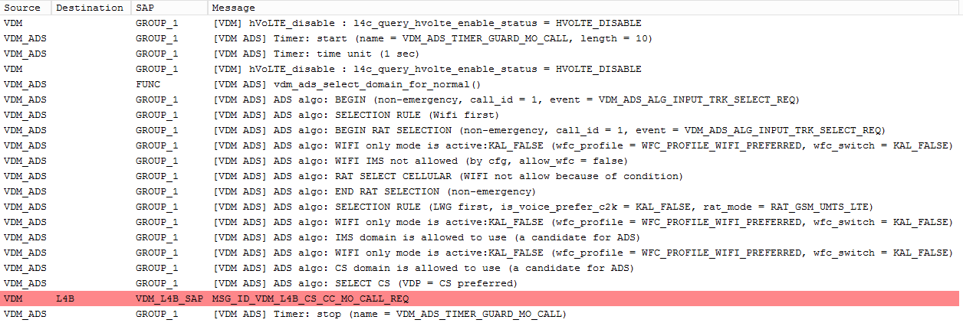
Case study – normal call example 1
not apply hVoLTE for normal call
selects CS

Slide 14
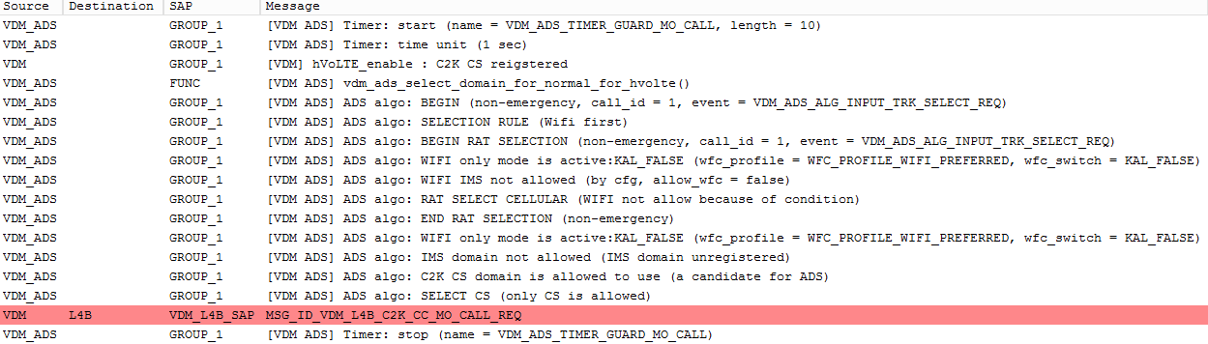
Case study – normal call example 2
apply hVoLTE for normal call
selects C2K CS

Slide 15
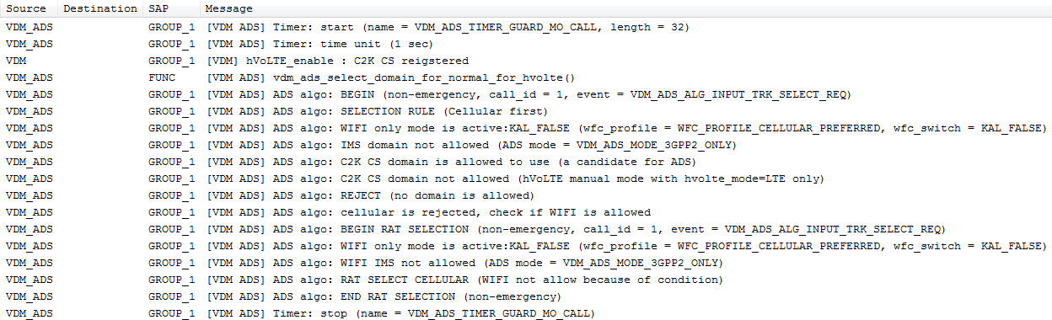
Case study – normal call example 3
apply hVoLTE for normal call
cannot select C2K CS due to hvolte_mode: LTE only
Need check VoLTE icon or L4 owner

Slide 16
Log Analysis – emergency call
emc scan enable for ECC call?
allow_global_emc_scan= ture
allow_global_emc_scan= false
[VDM ADS] vdm_ads_select_domain_for_emergency_for_hvolte()
[VDM ADS] vdm_ads_select_domain_for_emergency()

Slide 17
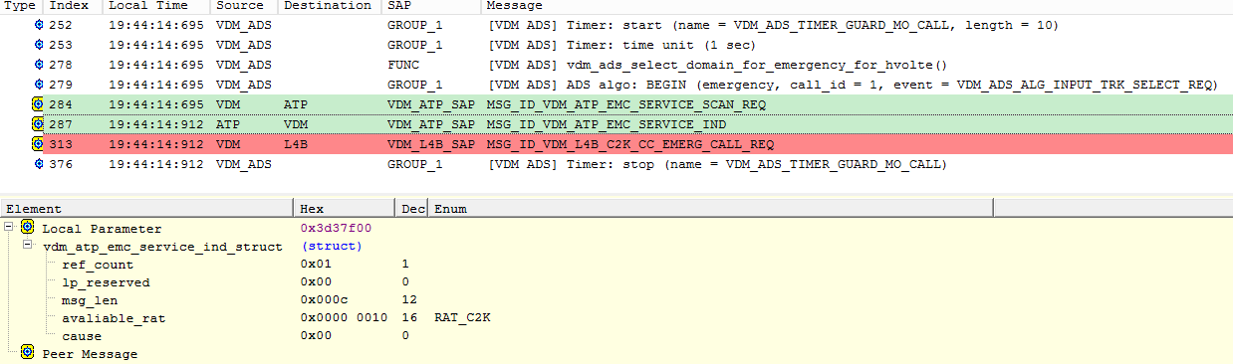
Log Analysis – emergency call
allow_global_emc_scan=ture
VDM will send EMC_SERVICE_SCAN_REQ (AT+EMCSS) toward L4C/GMSS for available rat to attempt E911
L4C/GMSS will response
available rat for VDM to attempt ECC or
LTE/GSM/UMTS/C2K
RAT_NONE for AP to change to global rat and redial
A
B
B

Slide 18
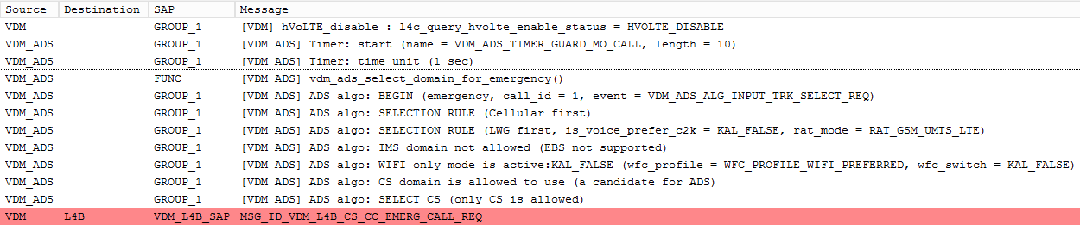
Case study – emergency call example 1
allow_global_emc_scan= false
selects CS

Slide 19
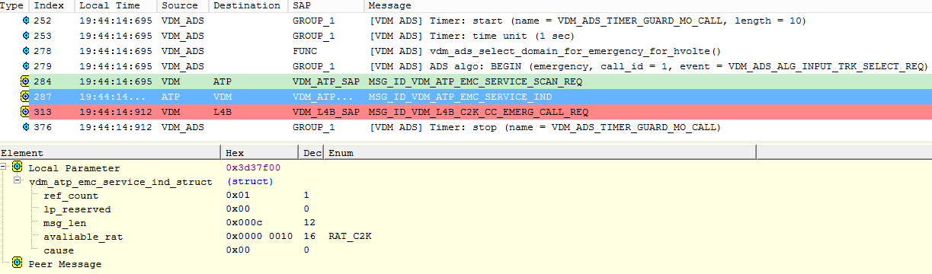
Case study – normal call example 2
allow_global_emc_scan= true
L4C/GMSS response with RAT_C2K, VDM selects C2K CS

Slide 20
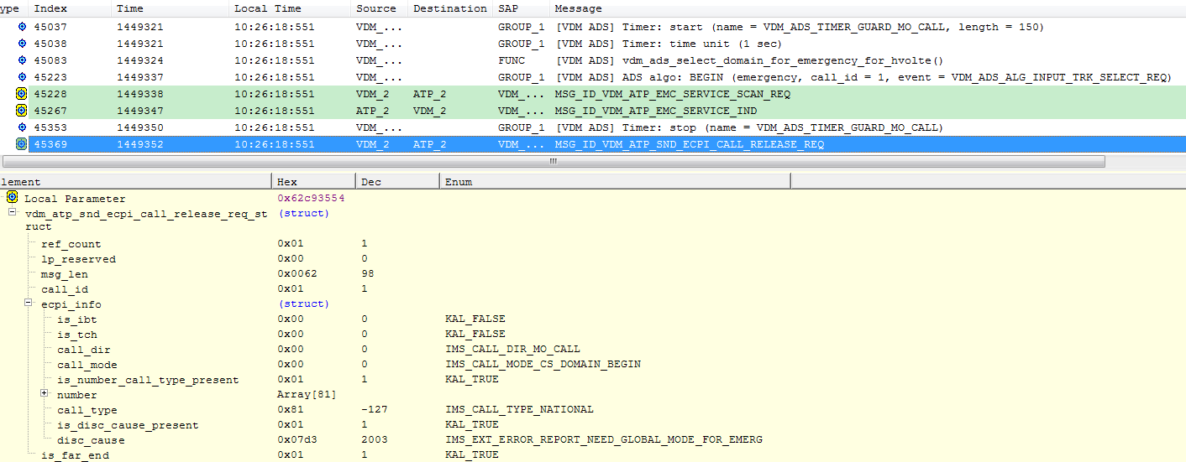
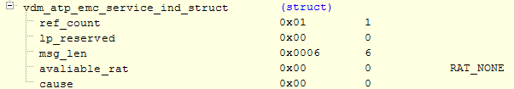
Case study – normal call example 3
allow_global_emc_scan= true
L4C/GMSS response with RAT_NONE, VDM reject to AP with cause 2003 for AP to change to global mode and redial by ATDER="<call_number>”,<call_id>

